Slide 1
DC Machine
Electrical machines– ELC2104

Slide 2
REFERENCE BOOK
M. G. Say, Alternating Current Machines (5e), ELBS.
2. E. H. Langsdorf, Theory of Alternating Current Machine (2e), TMH.
3. A. E. Clayton, Performance and Design of DC Machines (3e), O& IBH,
TEXT BOOKS
1. P. S. Bhimbra, “Electrical Machinery”, Seventh Edition, 1995,Khanna Publishers.
2. I. J. Nagrath, , D. P.Kothari, “Electric Machines”, Third Edition, Tata McGraw-Hill Publishing Company Ltd.
3. A. E.Fitzgerald, Charles Kingsley, Jr. Stephen D. Umans, “Electric Machinery”, Fifth Edition, Tata McGraw-Hill.

Slide 3
Direct Current (DC) Machines Fundamentals
Generator action: An emf (voltage) is induced in a conductor if it moves through a magnetic field.
Motor action: A force is induced in a conductor that has a current going through it and placed in a magnetic field.
Any DC machine can act either as a generator or as a motor.

Slide 4
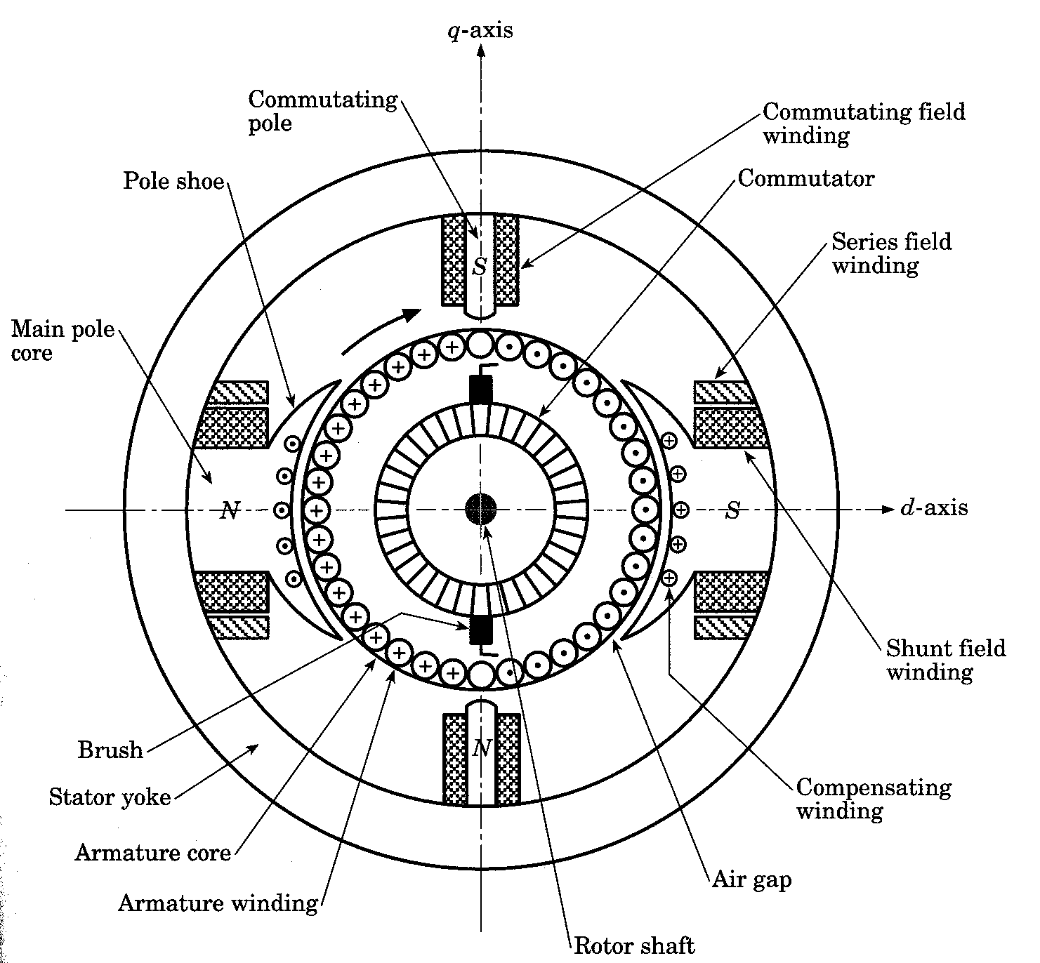
DC Machine Construction
The stator of the dc machine has poles, which are excited by either dc current or permanent magnets to produce magnetic fields.
In the neutral zone, in the middle between the poles, commutating poles are placed to reduce sparking of the commutator.
Compensating windings are mounted on the main poles. These reduces flux weakening commutation problems.

Slide 5
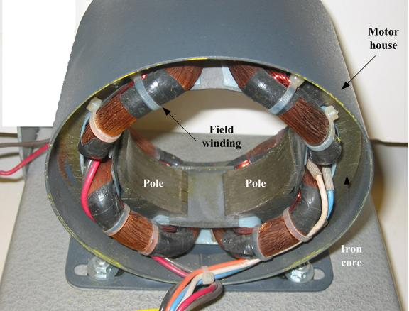
DC Machine Construction
The poles are mounted on an iron core that provides a closed magnetic circuit.
The rotor has a ring-shaped laminated iron core with slots.
Coils with several turns are placed in the slots. The distance between the two legs of the coil is about 180 electric degrees.

Slide 6
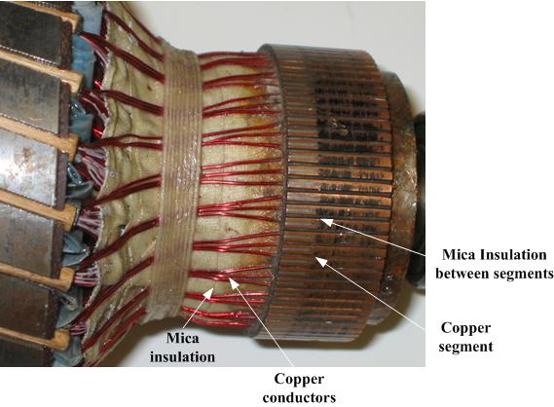
DC Machine Construction
The rotor coils are connected in series through the commutator segments.
The ends of each coil are connected to a commutator segment.
The commutator consists of insulated copper segments mounted on an insulated tube.
Two brushes are pressed to the commutator to permit current flow and they are placed in neutral zone.

Slide 7
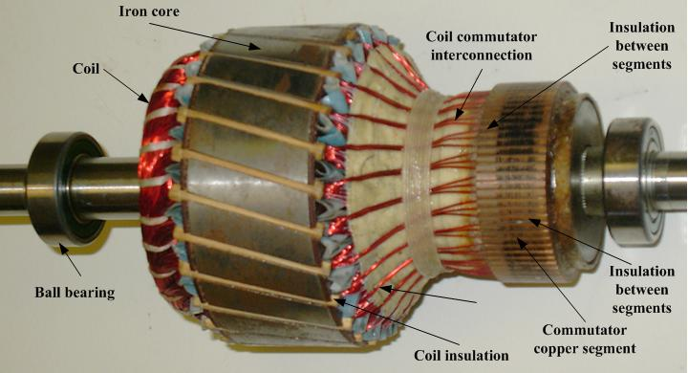
DC Machine Construction
The rotor coils are connected in series through the commutator segments.
The ends of each coil are connected to a commutator segment.
The commutator consists of insulated copper segments mounted on an insulated tube.
Two brushes are pressed to the commutator to permit current flow and they are placed in neutral zone.

Slide 8
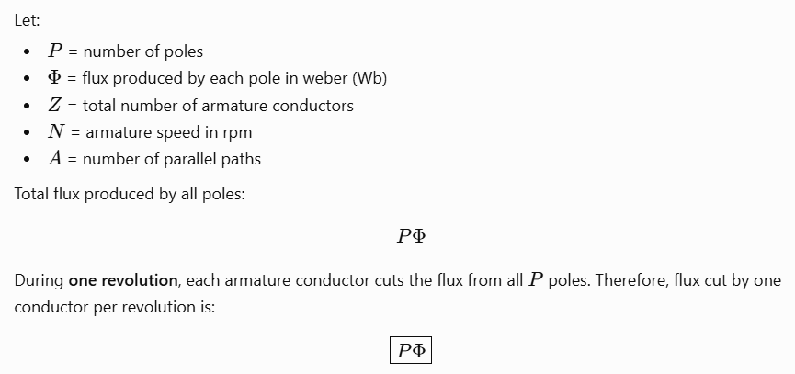
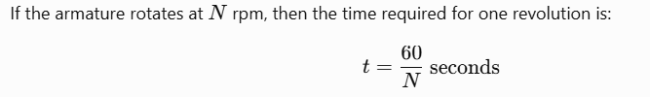
EMF Equation of DC Generator

Slide 9
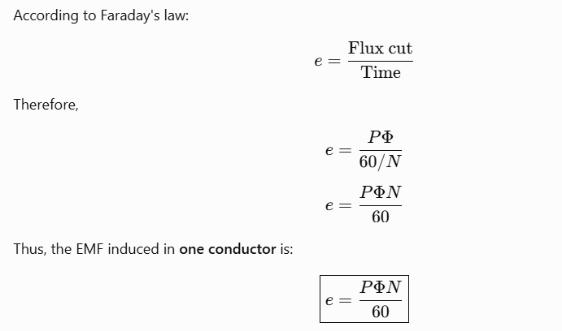

Slide 10
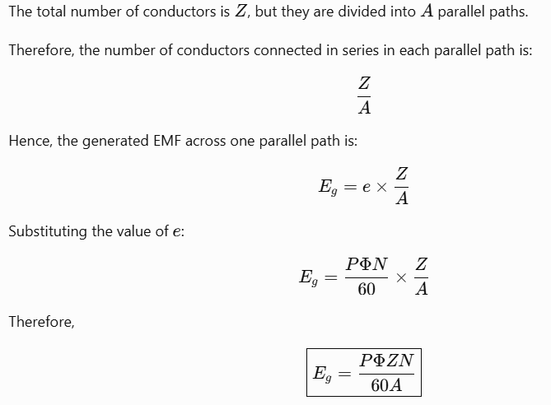

Slide 11
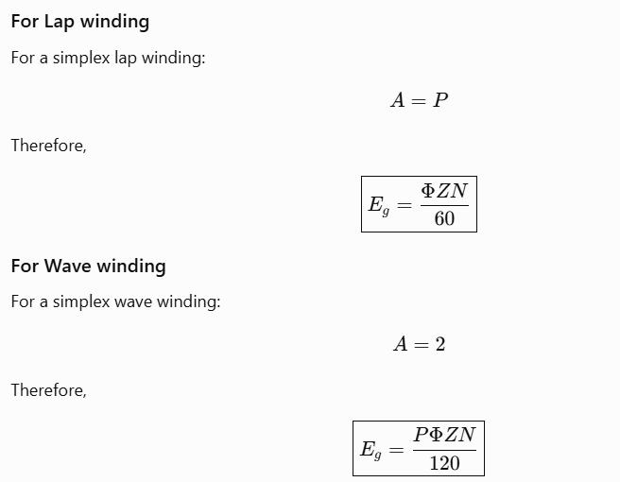

Slide 12
Type of DC GENERATORS
There are four major types of DC generators, namely
Separately excited generator.
Shunt generator.
Series generator
Compounded generator
  Cumulative
  Differential

Slide 13
The Equivalent Circuit of a DC Generator
Two circuits are involved in DC generators
Armature Circuit
Field circuit
Armature circuit represents Thevenin equivalent of the entire rotor.
It cantain an ideal voltage source EA and a resistor RA. .
Brush voltage drop is represented by a small battery
The field coils, which produce the magnetic flux
  inductor LF and resistor RF
  Radj for field current control

Slide 14
Magnetizing curve of a DC Generator & performance
The internal generated voltage EA of a dc generator is given by
EA is directly proportional to the flux
The field current is directly proportional to the magnetomotive force and hence EA
Brush voltage drop is represented by a small battery
Performance of the DC generators are determined by terminal output parameter IL and VT
Voltage regulation also determines its performance

Slide 15
The Separately Excited Generator
A separately excited dc generator is a generator whose field current is supplied by a separate external dc voltage source.
By Kirchhoff's voltage law, the terminal voltage is
Since the internal generated voltage is independent of lA the terminal characteristic of the separately excited generator is a straight line
A separately excited dc generator
The terminal characteristic (a) with and (b) without compensating windings

Slide 16
The Separately Excited Generator
Control of Terminal Voltage > two methods
Change the speed of rotation
E_{A} = KФω↑ >VT = EA ↑ - l_{A}R_{A} > VT ↑
Change the field current.
I_{F} = VF/R_{F}↓ > I_{F} ↑ > Ф ↑> E_{A} = KФ↑ω >
V_{T} = E_{A} ↑ - l_{A} R_{A} > VT ↑
The terminal characteristic (a) with and (b) without compensating windings

Slide 17

The Separately Excited Generator
It is not possible to predict analytically the value of E_{A} to be expected from a given field current.
Magnetization curve of the generator must be used to calculte E_{A} accurately.
Net mmf is and IF equivalent is
The magnetization curves for a generator are drawn for a particular speed, usually the rated speed of the machine.
If the machine is turning at other speeds than the EA in a machine is related to speed by

Slide 18
The Shunt Generator
A shunt dc generator is a dc generator that supplies its own field current by having its field connected directly across the terminals of the machine.
The armature current of the machine supplies both the field circuit and the load
The equivalent circuit of a shunt de generator

Slide 19
Shunt Generator
Voltage Build up in a Shunt Generator depends on
Residual flux
I_{F} = V_{T} ↑/R_{F} > E_{A} = KФ↑ω >
V_{T} = E_{A} ↑ - l_{A} R_{A} > VT ↑
possible causes for the voltage to fail to build up during starting
There may be no residual magnetic flux
The direction of rotation of the generator may have been reversed
The field resistance may be adjusted to a value greater than the critical resistance
Voltage buildup on starting in a shunt dc generator

Slide 20
Shunt Generator
The Terminal Characteristic of a Shunt DC Generator
I_{A} = I_{L} ↑ + I_{F} > (l_{A}R_{A} ) ↑ > V_{T} ↓ = E_{A} - I_{A} ↑ R_{A}
I_{F} ↓ = V_{T} ↓ /R_{F} > E_{A} = KФ ↓ ω >
V_{T} = E_{A} ↓ - l_{A} R_{A} > VT ↓
Voltage Control for a Shunt DC Generator
Change the shaft speed ω of the generator.
Change the field resistor of the generator,
The terminal characteristic of a shunt dc generator

Slide 21
Shunt Generator
The Non linear Analysis of Shunt DC Generators
The key to understanding the graphical analysis of shunt generators is to remember Kirchhoff's voltage law (KVL):
The field resistance R_{F}, which is just equal to V_{T}/I_{F}, a straight line
At no load V_{T} = E_{A}
The differnce between V_{T} and E_{A} is lARA
graphical analysis of shunt generators

Slide 22
Shunt Generator
If armature reaction is present in a shunt generator
There is demagnetizing magnetomotive force and lARA drop
graphical analysis of shunt generators with armature reaction

Slide 23
SERIES DC GENERATOR
A series dc generator is a generator whose field is connected in series with its armature. It has few turns of field coil with thick conductors.
The equivalent circuit of a series generator

Slide 24
SERIES DC GENERATOR
The Terminal Characteristic of a Series Generator
At no load
As I_{L} ↑= I_{A} = I_{F} > E_{A} ↑ - I_{A} ↑ (R_{F} +R_{A})
At the beginning E_{A} increases more than the resistive drop
Derivation of the terminal characteristic for a series dc generator

Slide 25

CUMULATIVELY COMPOUNDED DC GENERATOR
A cumulatively compounded dc generator is a dc generator with both series and shunt fields, connected so that the magnetomotive forces from the two fields are additive.
Voltage and current relationships for this generator are
Since there are series and shunt field coils, the equivalent effective shunt field current for this machine is given by
The equivalent circuit of a compound dc generator

Slide 26
The Compound Generator
The Terminal Characteristic of a Cumulatively Compounded DC Generator
Since I_{A} = I_{F} + I_{L} ↑, the armature current I_{A} increases too. At this point two effects occur in the generator:
As I_{A} increases, V_{T} ↓ = E_{A} - I_{A} ↑ (R_{A} + R_{s}).
As I_{A} increases, , increasing
The field resistance R_{F}, which is just equal to V_{T}/I_{F}, a straight line
V_{T} = E_{A} ↑- I_{A}(R_{A} + R_{s}) rise.
Terminal characteristics of cumulatively compounded dc generators

Slide 27

The Compound Generator
Graphical Analysis of Cumulatively Compounded DC Generators
The following two equations are the key to graphically describing the terminal characteristics of a cumulatively compounded dc generator.
The equivalent shunt field current Ieq , and
the total effective shunt field current
This equivalent current Ieq represents a horizontal distance to the left or the right of the field resistance line (RF = VT/IF) along the axes of the magnetization curve.

Slide 28
Commutation Process
Commutation is the process of converting the ac voltages and currents in the rotor of a dc machine to dc voltages and currents at its terminals.
The 4 loops of this machine are laid into the slots in a special manner. The “unprimed” end of each loop is the outermost wire in each slot, while the “primed” end of each loop is the innermost wire in the slot directly opposite.

Slide 29
Commutation Process
The voltage in each of the 1, 2, 3’ and 4’ ends of the loops is given by:
  eind = vBl (+out of page)
The voltage in each of the 1’, 2’, 3 and 4 ends of the loops is given by:
  eind = vBl (+into page)
the total voltage at the brushes
  E=4e
The winding’s connections

Slide 30
Commutation Process
The machine at time ωt=45°.

Slide 31
Commutation Process
The machine at time ωt=90°.
the 1’, 2, 3, and 4’ ends of the loops are under the north pole face
the 1, 2’, 3’ and 4 ends of the loops are under the south pole face
so the terminal voltage E=4e

Slide 32
Problems with Commutation in Real Machines
Armature reaction
The current though the
armature conductors set
up a magnetic field
surrounding it which
has the following effects
  Weakens the main flux
  Distorts the main flux
  Neutral plan shift

Slide 33
Problems with Commutation in Real Machines
L(di/dt) Voltage
Occurs in the commutator segments being shorted
out by the brushes > inductive kick
These effects causes
  Arcing and sparking at the brushes
  Flashover
    Reduce brush life
    Pitting of the commutator segment

Slide 34
Solutions to Problems with Commutation in Real Machines
Brush shifting
Commutating poles or interpoles
Compensating windings

Slide 35
Solutions to Problems with Commutation in Real Machines
Commutating poles or interpoles
It cancels the voltage in the coils undergoing commutation
interpole windings are in series with the rotor windings
as the rotor current incleases flux produced by interpole also inceases
producing an oppssing effect to that of neutral plan shift

Slide 36
Solutions to Problems with Commutation in Real Machines
Compensating winding
Solves the problem of flux weakening and neutral plane shift
Compensating windings are in series with the rotor windings
placing in slots carved in the faces of the poles parallel to the rotor conductors

Slide 37
DC Motor

Slide 38



The Internal Generated Voltage Equations Of Real Machines
The induced voltage in any given machine depends on three factors:
The flux Φ in the machine
The speed ω of the machine's rotor
A constant depending on the construction of the machine
the voltage equation in terms of rpm
The voltage out of a real machine = the number of conductors per current path x the voltage on each conductor

Slide 39

The Induce Torque Equations Of Real Machines
The torque in any dc machine depends on three factors:
The flux Φ in the machine
The armature (or rotor) current IA in the machine
A constant depending on the construction of the machine
The torque on the armature of a real machine =the number of conductors Z x the torque on each conductor

Slide 40
Power Flow and Losses in DC Machines
Electrical or copper losses (I² R losses)
Brush losses
Core losses
Mechanical losses
Stray load losses
Brush losses
Core losses
Copper losses
the hysteresis losses and eddy current losses occurring in the metal of the motor. These losses vary as B² and, for the rotor, as the (n^{1.5})
Armature loss:
Field loss:

Slide 41
Power Flow and Losses in DC Machines
Mechanical losses
Friction losses are losses caused by the friction of the bearings in the machine
Windage losses are caused by the friction between the moving parts of the machine and the air inside the motor's casing
Stray losses
Unknown losses
By convention to be 1 percent of full load

Slide 42
The Power-Flow Diagram
Power-flow diagrams for Generator
Power-flow diagrams for Motor.

